Slide 2

Accelerate your WinUI 3 app with the Windows Community Toolkit
Michael A. Hawker 🦙 (aka XAML Llama)

Slide 3

Who am I?
Michael A. Hawker (he/him)
a.k.a. XAML Llama 🦙
Senior Software Engineer @ Microsoft
Maintainer of the Windows Community Toolkit (WCT)
Created XAML Studio
@XAMLLlama

Slide 4

Overview
Community Toolkits in a Nutshell
Windows UX Framework Crash Course (WinForms, WPF, UWP, WinUI… Oh My!!!)
The Essence of XAML
Starting an App in Visual Studio

Slide 5


Community Toolkits
A collection of libraries that are:
For .NET based technologies
Open Source on GitHub, MIT Licensed
Part of .NET Foundation
Collaboration of Community Developers, Microsoft MVPs, Microsoft Engineers, and the teams working on those technologies
aka.ms/toolkit

Slide 6



Community Toolkit Organization
.NET Community Toolkit Platform agnostic MVVM Toolkit
w/ Source Generators!
High Performance Helpers
Diagnostics (Guard/ThrowHelper APIs)
MAUI Community Toolkit Controls, extensions, behaviors & markup
Windows Community Toolkit Controls, extensions & behaviors
Graph helpers
Toolkit Labs Intelligent APIs
Gaze controls
Windows Community Toolkit Labs 🆕
Nov 9, 21:00 PST
Nov 10, 00:30 PST
Nov 10, 14:30 PST

Slide 7

Our Community of
Contributors

Slide 8
Frameworks: A History
MFC C++ (Win32)
WinForms C# (Win32)
WPF C# (Win32)
UWP C++ / C# (Sandbox)
WinUI 3 C++ / C# (Win32)

Slide 9
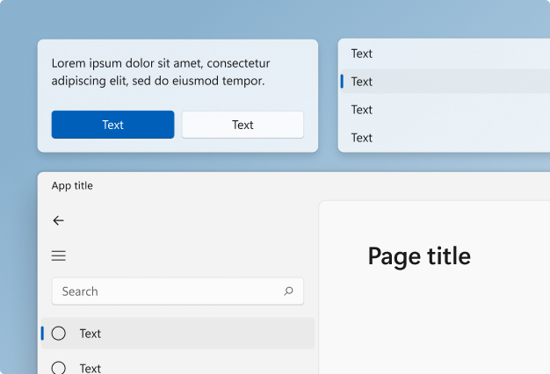
WinUI 3
Always contains the latest & greatest Fluent controls & styles
Best User experience on Windows
Native UI performance in any app (C++ or .NET)
Supports .NET 6+ and latest C# versions
You decide when you upgrade
Part of the Windows App SDK
Used by MAUI and Uno Platform to target Windows platform

Slide 10
Why Version 3?
Win OS Agnostic
Windows Community Toolkit (Future 8.0 – C# Only) CommunityToolkit.WinUI.*
WinUI 2 Controls Microsoft.UI.Xaml
WinUI 3 Controls + “Rendering” Microsoft.UI.Xaml
UWP XAML “Rendering”
Windows.UI.Xaml
Win OS Dependent
C# .NET Native .NET Standard 2.0
C#/WinRT
.NET 6+

Slide 11
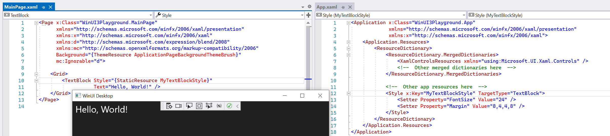
XAML is eXtensible Application Markup Language
XAML is like a combination of HTML + CSS but using XML & used to define both:
Layout / Presentation of an Application
Style / Look-and-feel of components
XAML developers generally separate these concerns:
Pages for content
Resources / ResourceDictionary for styles

Slide 12
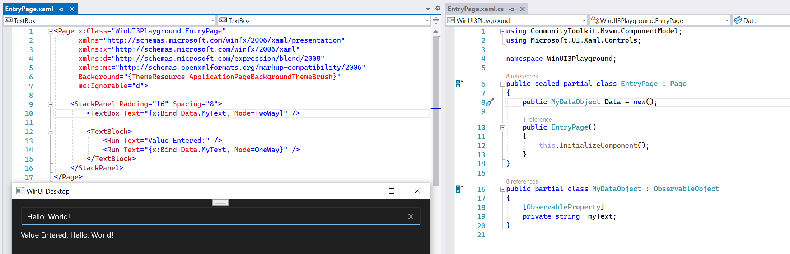
Data Binding auto-updates the UI
Reduces need for code that just manipulates UI
(If you’re doing this, there’s usually a better way!)
Usually handled by following the MVVM pattern
(Hey, we have a Toolkit for that! 😉)

Slide 13
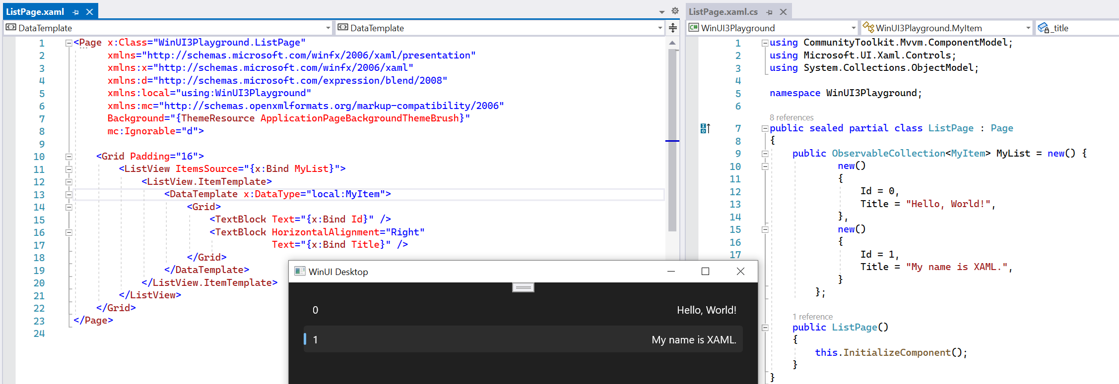
Look of an Object
DataTemplates take your object and display it using a specific set of UI elements via Data Binding:

Slide 14
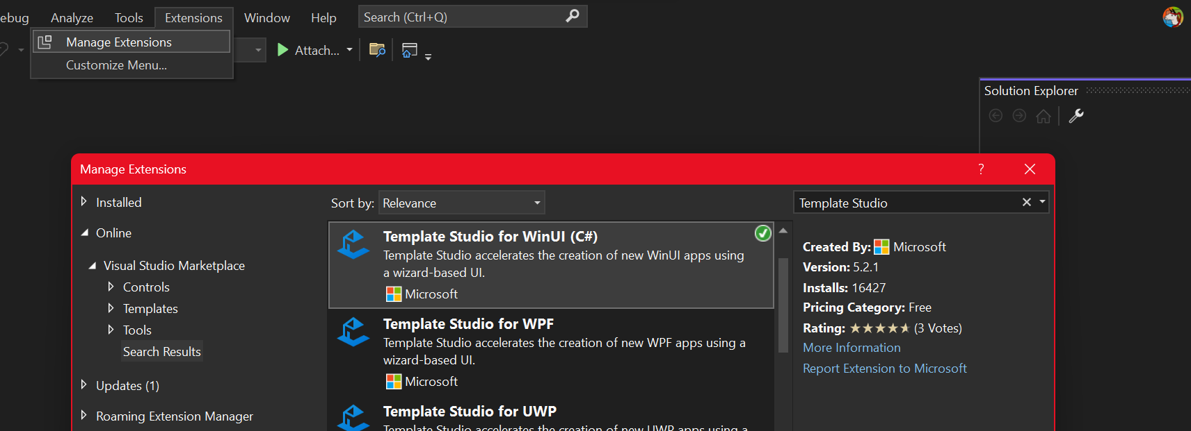
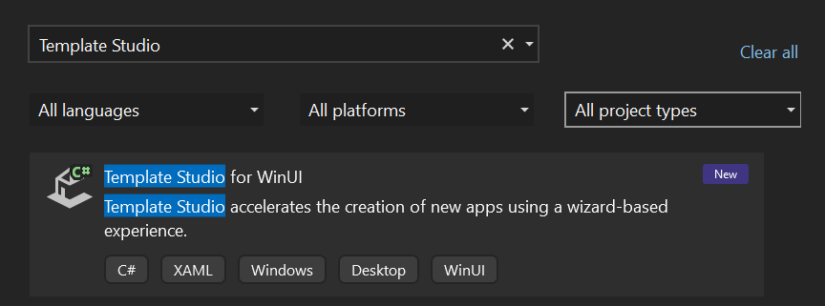
Getting Started
Visual Studio 2022 17.1+
https://aka.ms/winui3
.NET Desktop Development Workload
Windows 10 SDK (10.0.19041.0)
Windows Template Studio https://aka.ms/wts
Windows Community Toolkit https://aka.ms/toolkit/windows
Windows Community Toolkit Labs 🧪 https://toolkitlabs.dev/

Slide 15

Let’s start an App!

Slide 16

Links
https://toolkitlabs.dev
https://aka.ms/ifdef
https://aka.ms/toolkit/docs
https://aka.ms/toolkit/windows
🦙 @XAMLLlama

